Slide 1

Profile Web created using HTML, CSS, JS

Slide 2
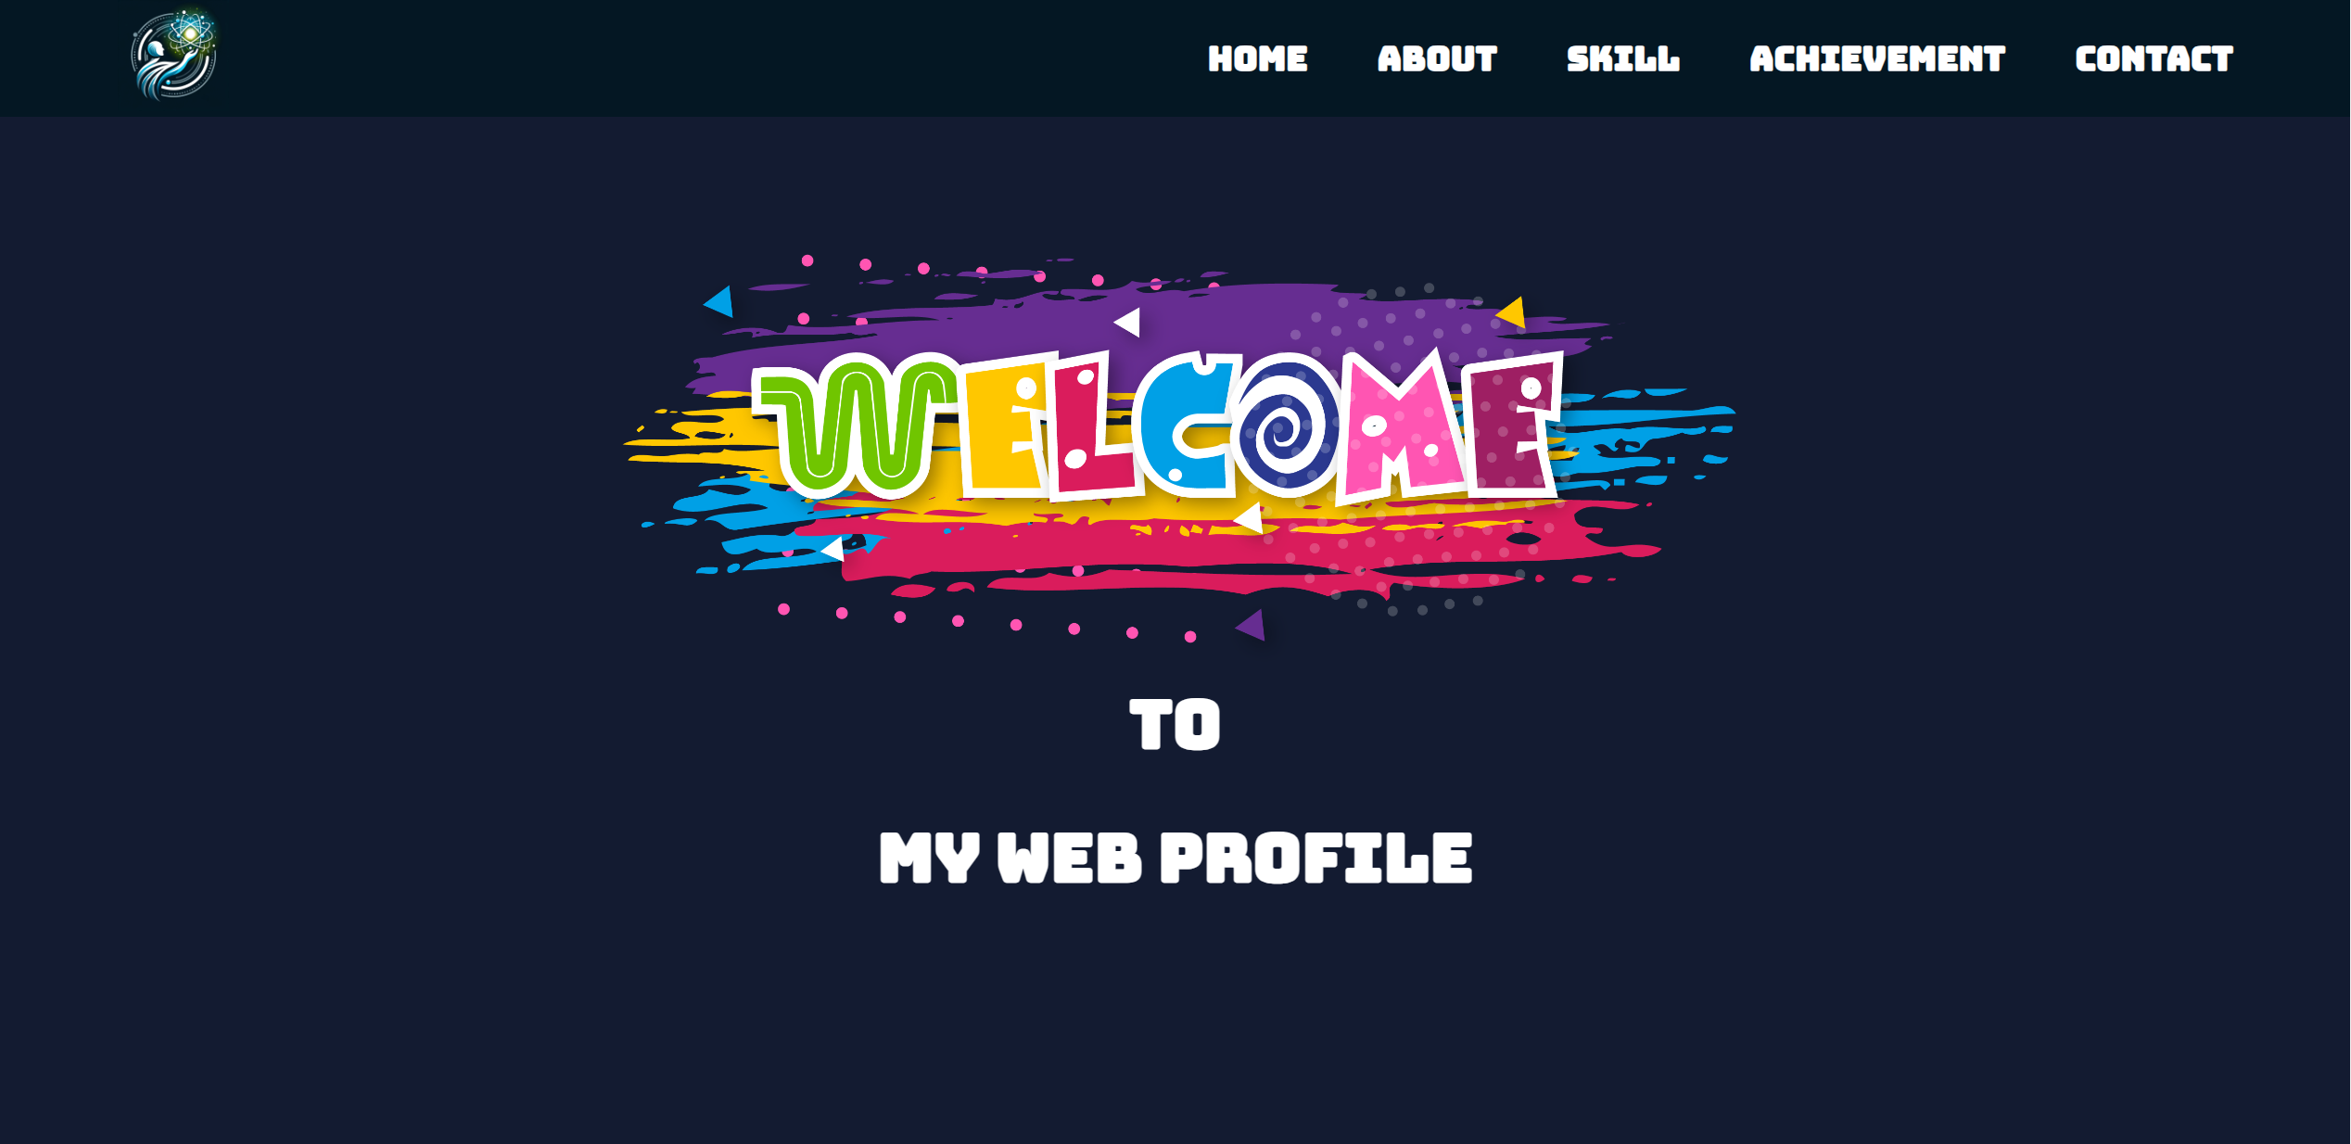
Header, Navigation, Home View

Slide 3
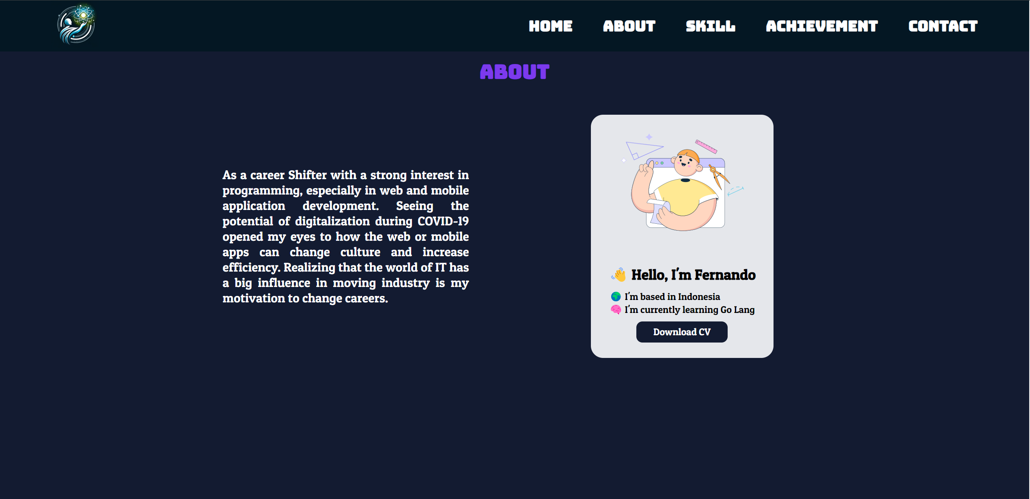
About View
z
x
c
n
m

Slide 4

Skills View

Slide 5
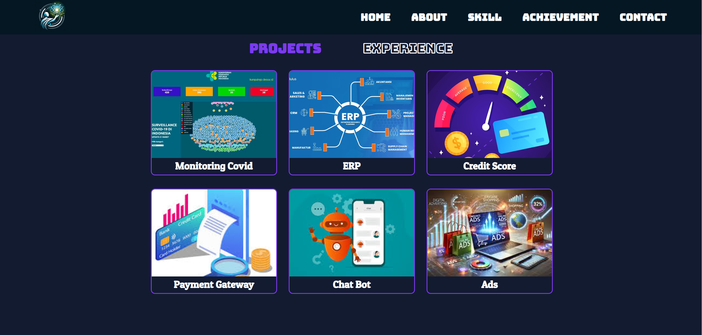
Achievement View (Projects)

Slide 6
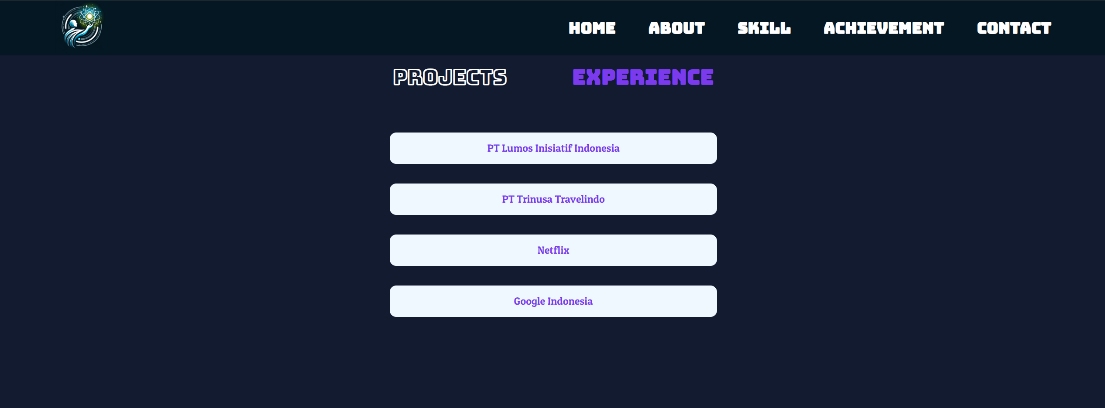
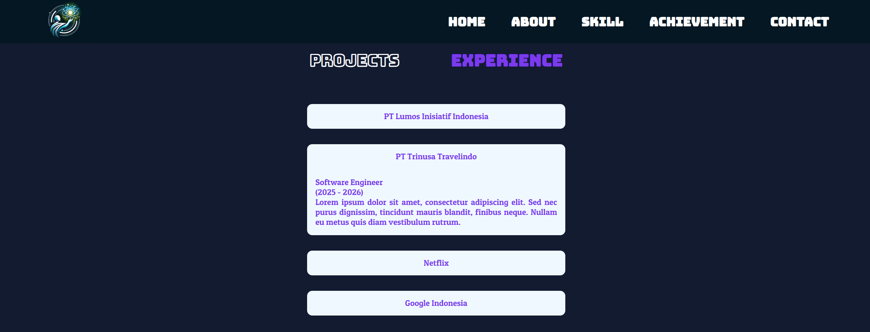
Achievement View (Experiences)

Slide 7
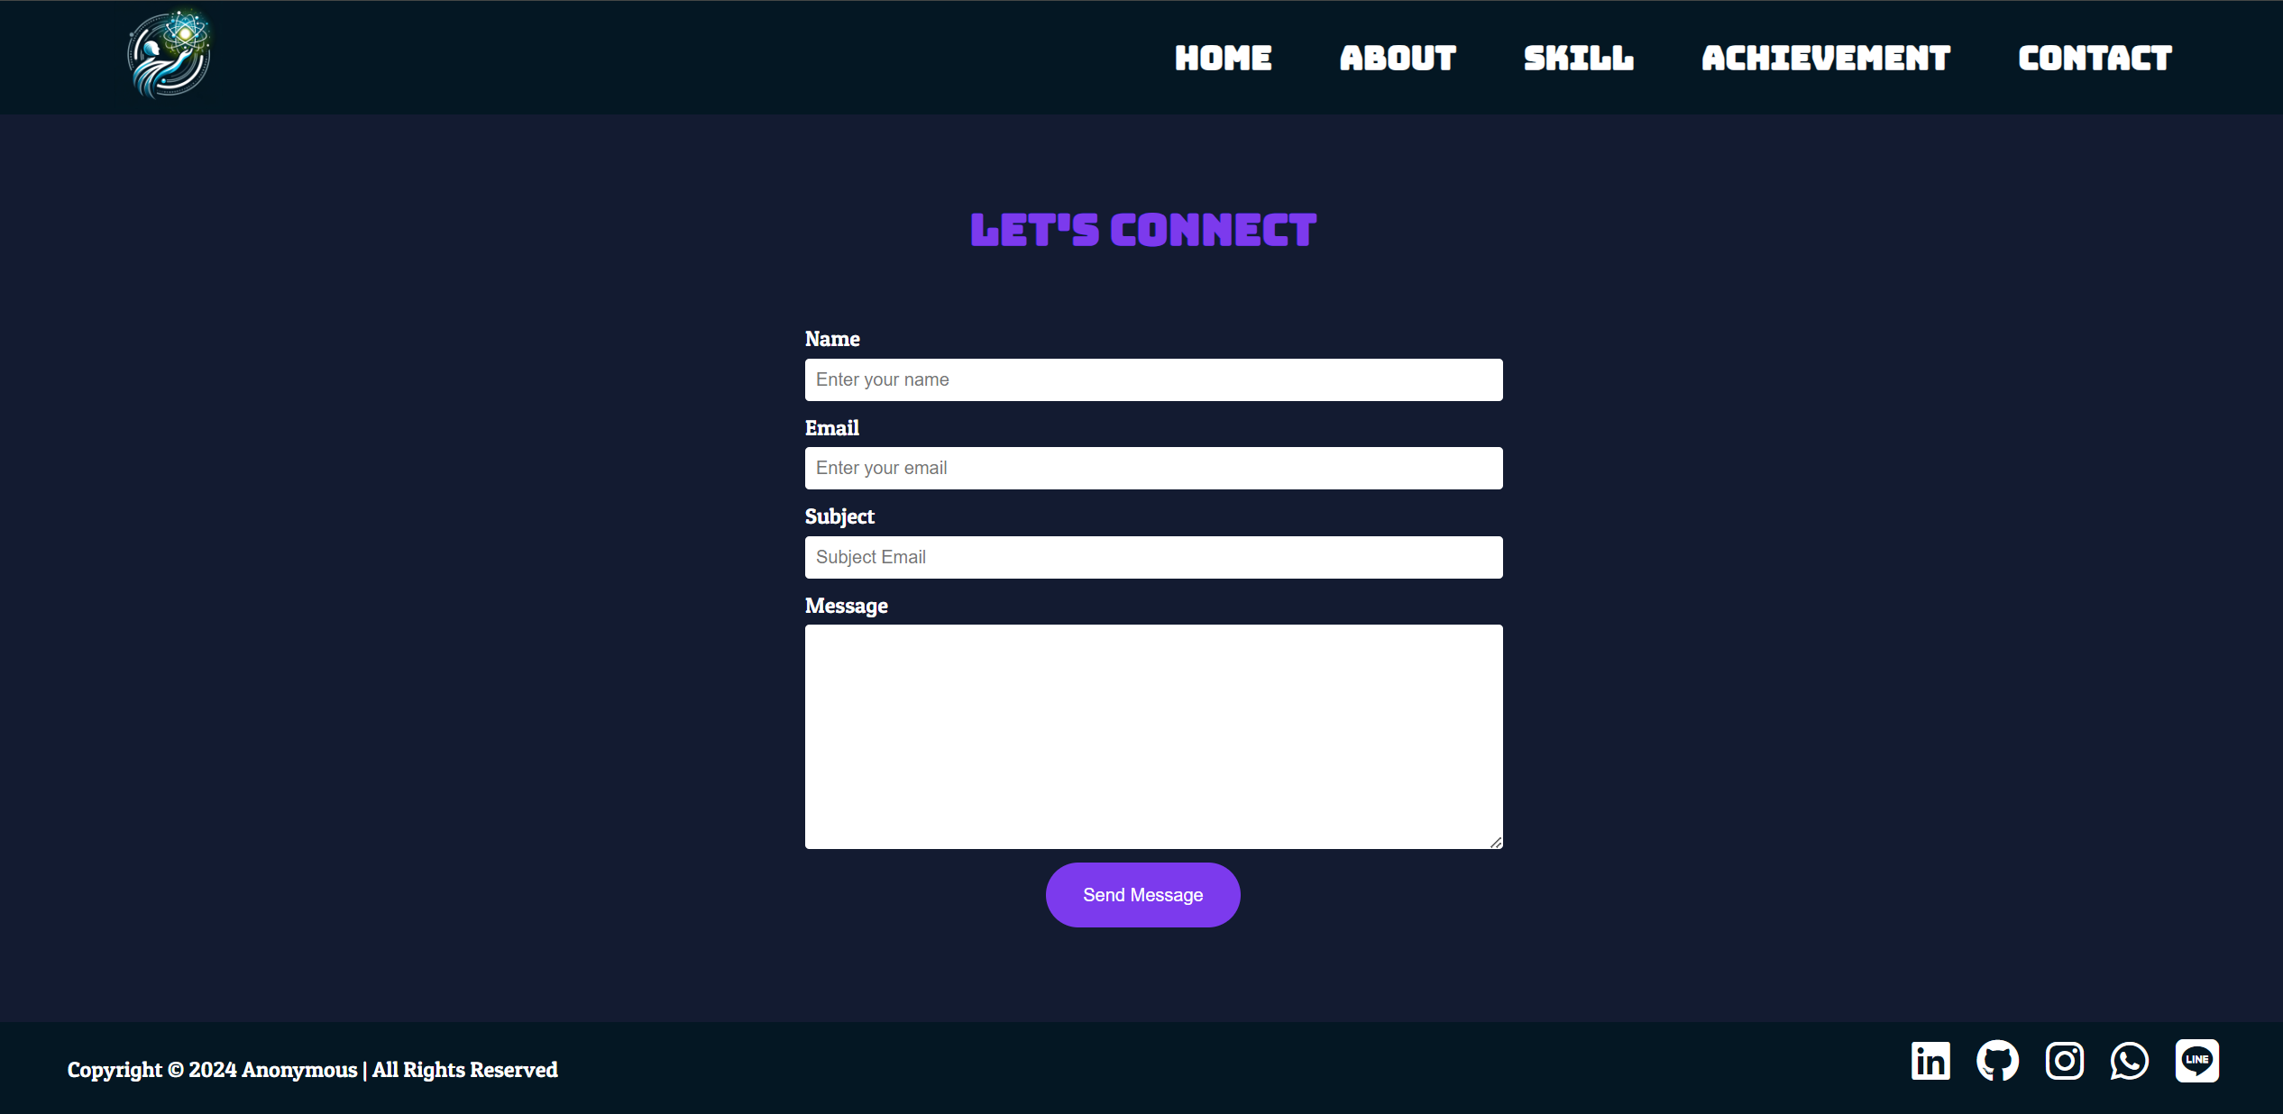
Contacts View & Footer

